Slide 1
Fresh Food App
Group 27 members: Wasay Ahmed (wahmed9), Christian Gutierrez (cgutie38), Jordan Nguyen (jtn3), Natalie Reyes (nreyes28)

Slide 2

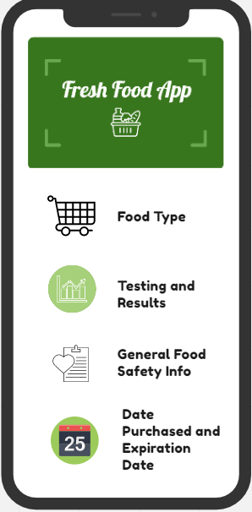


Project Description
Provides the user with information on food edibility
Separate hardware is used to test food item
Sensors built in the hardware will collect data on chemical odors read
App will calculate edibility and estimate expiration from real time data sent by the sensors
Purpose:
Reduce food waste
Increase food safety
Reduce the emissions of greenhouse gasses.
Notes:
Provides information on food edibility by analyzing the chemical components of the odor released by food.
Separate hardware can be used to wrap around, place on, hover over, or stab in the food item being tested
Chemical makeup of the odor is read by external odor sensors built in the hardware and the data is sent to the app through bluetooth connection which will calculate edibility and estimate days til inedible depending on the type of food.
Removes the guesswork of deciding whether food has gone bad.
Reduce food waste
Increase food safety
Reduce the emissions of greenhouse gasses.

Slide 3
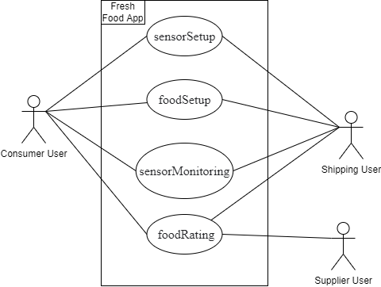
Use Case
Diagram
Sensor setup: press “Sensor Setup” button, install sensors (test using Bluetooth or wifi), calibrate, press “Finish Setup” button.
Food setup: press “Food Setup” button, input food, place food near sensor, and press “Finish Setup” button.
Sensor Monitoring: press “View Food Monitoring” for data predictions, on date of expiration gives user a notification to dispose food, press “Stop Monitoring” once food is gone, new notification to start new Food Setup.
Food Rating: User leaves review to supplier, finish by pressing “Submit Review”
Use Case diagram of Fresh Food App.

Slide 4



Requirements
All users must learn to navigate application and choose food to test.
Transporter tests during transportation checking supply and reporting to supplier.
Consumer and supplier can view food safety info, estimated expiration , and access rating system.
Cloud database updated frequently for user and food item information.
Will have option to translate into other languages but English will be the default.
ADA Compliant.
We have all users sign terms and conditions that show our app is not liable for any damages that are caused by spoiled food not identified by the app.

Slide 5
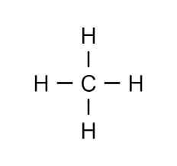
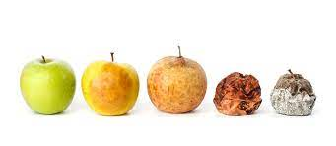
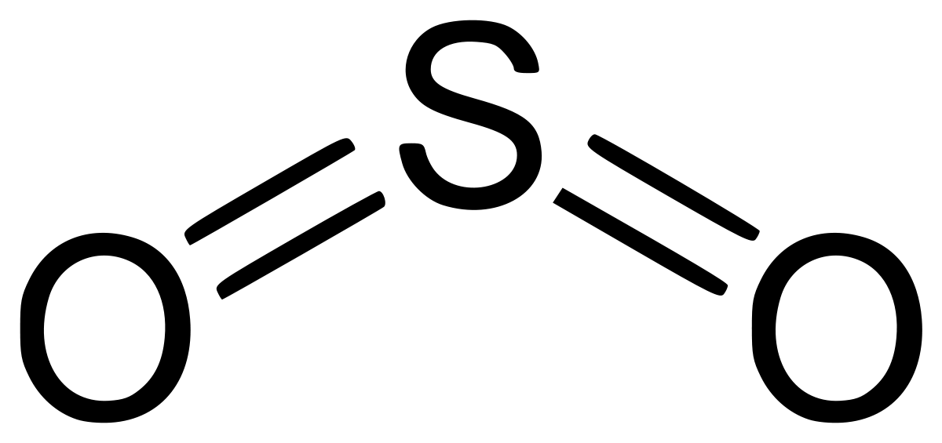
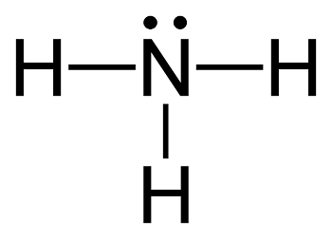
Requirements
Sensor Requirements
Different types of foods emit different gases when they begin to spoil.
Sensors must accurately detect gases for predictions (Ammonia, Methane, and Sulphur).
Sensors must measure environment conditions (Temperature and Humidity).
Data Requirements for Predictions
Previous gas and environment measurements of spoiling food need to be collected.
Real time measurements must then be compared with standardized data to make predictions.
Predictions should also be calculated with only real time data measurements.
Methane
Sulfur Dioxide
Ammonia

Slide 6
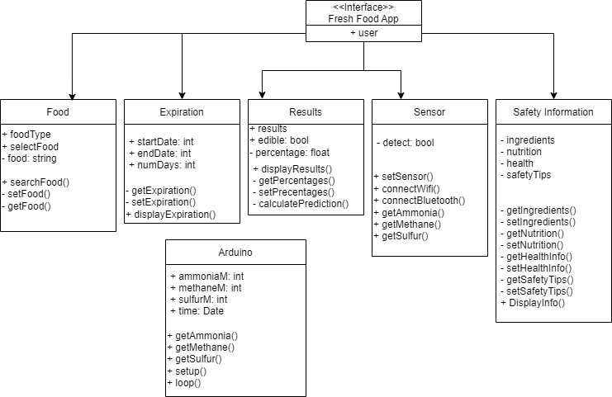
UML

Slide 7
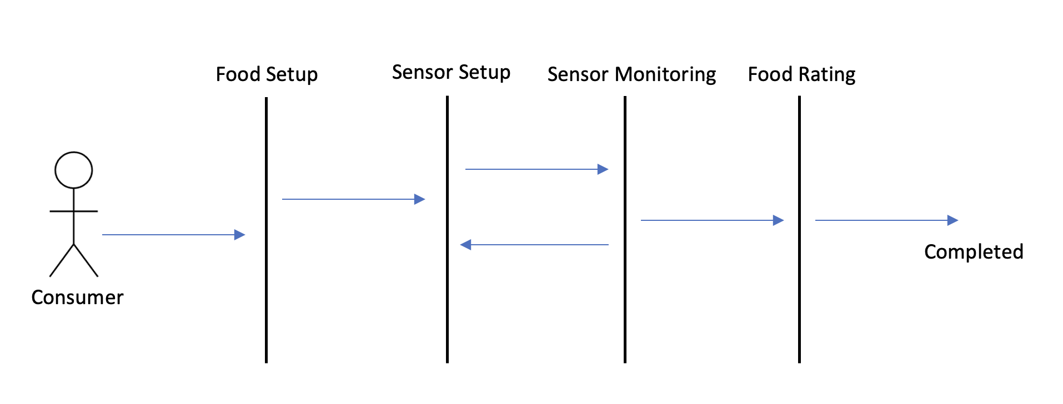
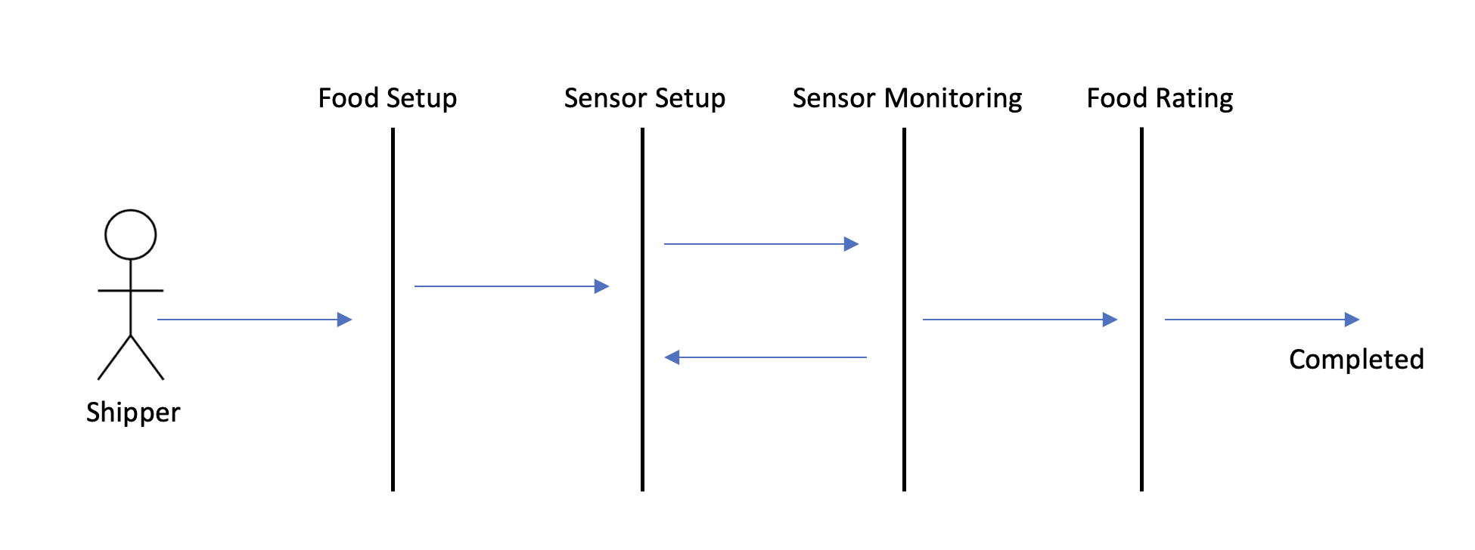
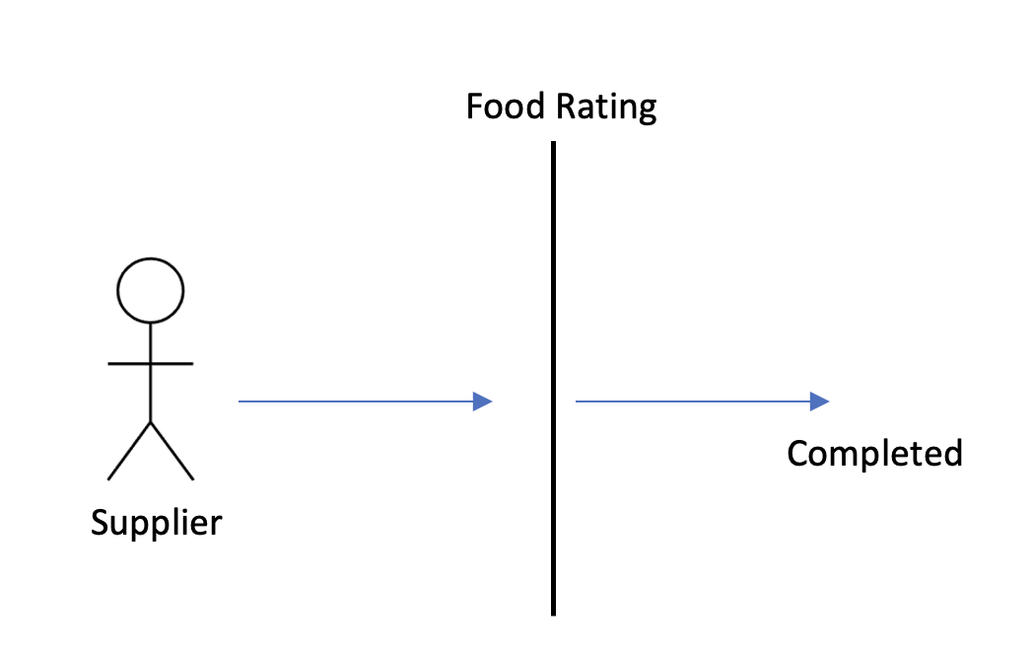
Sequence Diagrams

Slide 8

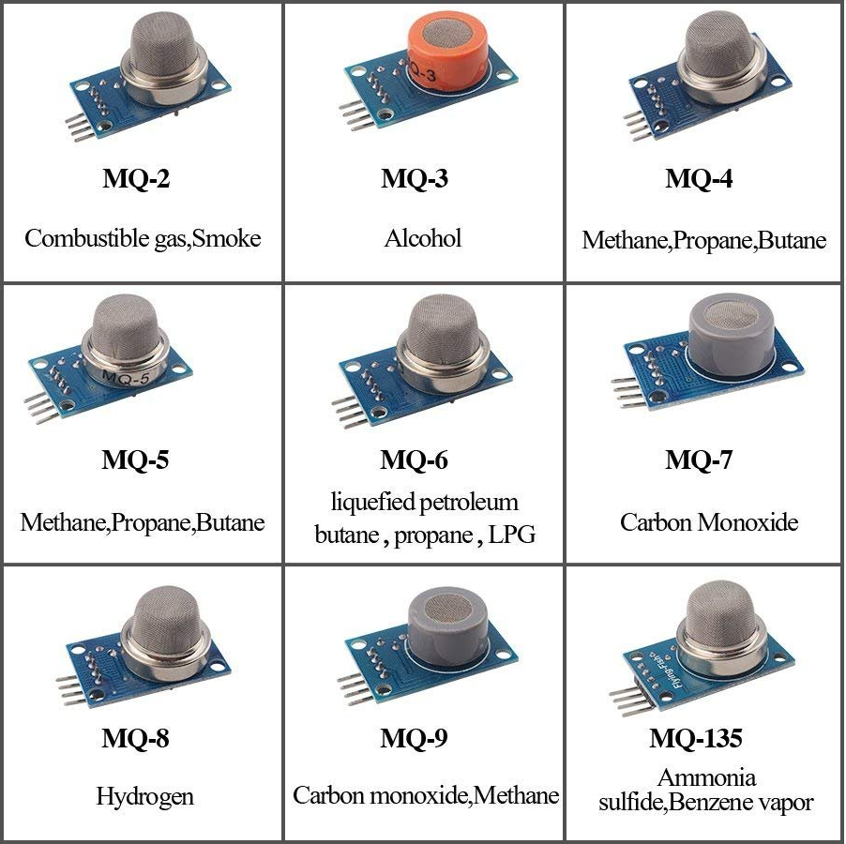

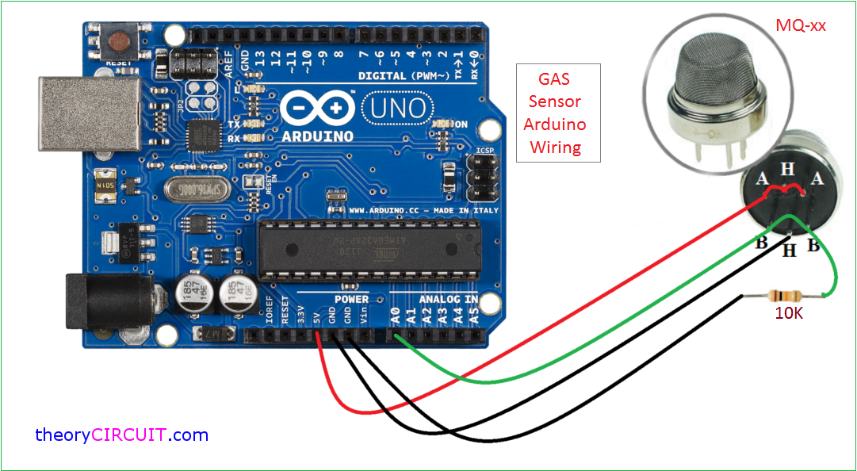




Design
Arduinos with MQ series gas sensors for measurements. Send data over Bluetooth or WiFi.
Python or Arduino C++ to retrieve data and calculate predictions. Send to database and app.
Cloud database to store and easily access all data from any device.
Android or iOS app with a nice UI to monitor their food. Should receive sensor data directly.

Slide 9

Project Issues
Arduino
Sending data over bluetooth from an arduino to an app might be difficult.
Future developers should consider separate systems for arduino and app.
Only share cloud database.
Container
Some gases are lighter than air and rise to the top (Ammonia and Methane).
Sensors in an open environment might not measure them accurately.
Smaller enclosed containers should be considered and tested to standardize measurements.
Buildups and escapes of gases must be factored in prediction calculations.
Types of Gas Emissions
Not all gases emitted are pure ammonia, sulphur, and methane.
Sensors should be able to detect all necessary variants of gases emitted for accurate predictions.

Slide 10
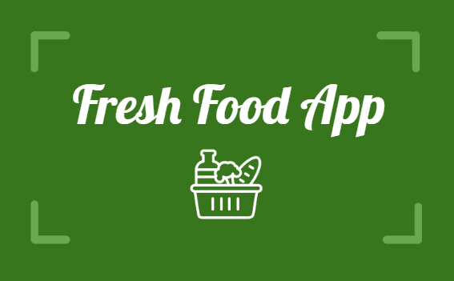
Thank You!

